Slide 1


<Dang Van Hiep>
<02-Feb-2024>

Slide 2

Outline
Executive Summary
Introduction
Methodology
Results
Conclusion
Appendix

Slide 3
Executive Summary
Summary of methodologies
Collecting the Data
Data Wrangling
Exploratory Analysis Using SQL
EDA with Visualization
Data Visualization with Folium
Interactive Dashboard with PlotlyDash
Machine Learning Prediction (Classification)
Summary of all results
Exploratory Analysis Results
Interactive Visualization Results
Predictive Analysis Results

Slide 4
Introduction
Project background and context
The commercial space age is here, companies are making space travel affordable for everyone. Virgin Galactic is providing suborbital spaceflights. Rocket Lab is a small satellite provider. Blue Origin manufactures sub-orbital and orbital reusable rockets. Perhaps the most successful is SpaceX.
The second stage of a rocket helps bring the payload to orbit, but the first stage does most of the work and is much larger.
SpaceX advertises Falcon 9 rocket launches on its website with a cost of 62 million dollars; other providers cost upward of 165 million dollars each, much of the savings is because SpaceX can reuse the first stage.
The Space Y company would like to compete with SpaceX founded by Billionaire industrialist EllonMusk.
Problems you want to find answers
If we can determine the first stage of landing, we can determine the cost of a launch.

Slide 5

Section 1

Slide 6
Methodology
Executive Summary
Data collection methodology:
From SpaceX REST API
With Web Scraping from Wiki page
Perform data wrangling
Dealing with Missing Values, Feature Engineering, Scaling, Dummies Encoding
Perform exploratory data analysis (EDA) using visualization and SQL
Perform interactive visual analytics using Folium and Plotly Dash
Perform predictive analysis using classification models
Sklearn LogisticRegression , SVM, DecisionTreeClassifier , KNeighborsClassifier algorithms
GrigSearch parameters tuning, 10 folds Cross Validation

Slide 7
Data Collection
There are 2 way to collect data:
SpaceX REST API
Performed GET request to the SpaceX REST API various endpoints starting with
https://api.spacexdata.com/v4/
Responses in the form of a list of JSON objects were gathered
JSON format was converted into Pandas DataFrameusing the json_normalizefunction
Web Scraping
Performed an HTTP GET request to the Falcon9 Launch HTML Wiki page
Used Python BeautifulSouppackage to web scrape HTML tables from response
Parsed the data from HTML tables and converted into a Pandas DataFrame

Slide 8
Data Collection – SpaceX API
GET request to SpaceX RESTAPI
spacex_url="https://api.spacexdata.com/v4/launches/past"
response = requests.get(spacex_url)
content = response.json()
data = pd.json_normalize (content)
https://github.com/hiepdv/My-submission-Applied-Data-Science-Capstone/blob/042e2c1c8dbd607237683e88fd9035addc18d9cd/Hiepdv-DataCollectionAPI.ipynb

Slide 9
Data Collection - Scraping
static_url="https://en.wikipedia.org/w/index.php?title=List_of_Falcon_9_and_Falcon_Heavy_launches&oldid=1027686922"
response = requests.get(static_url).text
soup = BeautifulSoup(response,'html.parser')
Web Scraping Using Python BeautifulSoup
https://github.com/hiepdv/My-submission-Applied-Data-Science-Capstone/blob/042e2c1c8dbd607237683e88fd9035addc18d9cd/Hiepdv-DataCollectionWebscraping.ipynb

Slide 10
Data Wrangling
Payload Mass missing values replaced with mean value (SpaceX API code)
Calculated the percentage of the missing values in each attribute
Identified which columns are numerical and categorical
Determined the number of launches on each site
Determine the number and occurrence of each orbit
Created a landing outcome label from Outcome column
https://github.com/hiepdv/My-submission-Applied-Data-Science-Capstone/blob/0f06c656917dee12b9ea23e824bca77308310a4a/Hiepdv-DataWrangling.ipynb

Slide 11
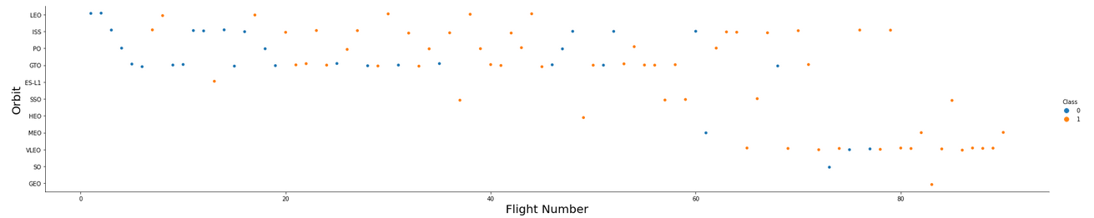
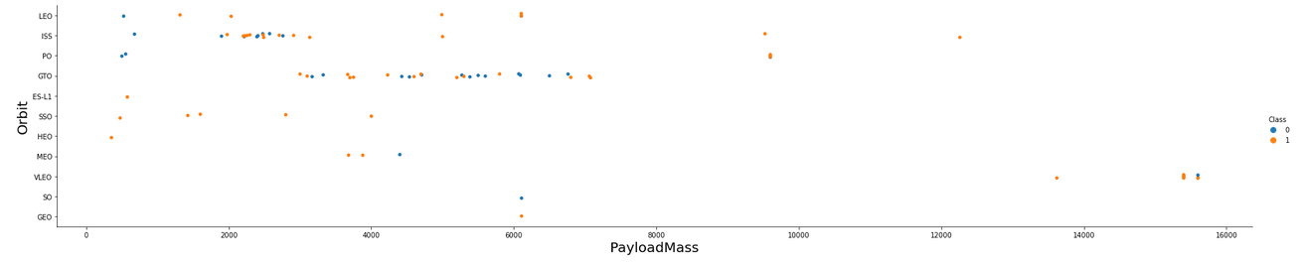
EDA with Data Visualization
https://github.com/hiepdv/My-submission-Applied-Data-Science-Capstone/blob/0f06c656917dee12b9ea23e824bca77308310a4a/Hiepdv-EDA_DataVisualization.ipynb

Slide 12
EDA with SQL
select unique(LAUNCH_SITE) from SPACEXTBL
select *from SPACEXTBL where LAUNCH_SITE like'CCA%' limit(5)
select SUM(payload_mass__kg_)from SPACEXTBLwherecustomer='NASA (CRS)'
select avg(payload_mass__kg_)from SPACEXTBLwhere booster_versionlike 'F9 v1.1'
select min(DATE)from SPACEXTBLwhere Landing_Outcome= 'Success (ground pad)'
select booster_versionfrom SPACEXTBLwhere Landing_Outcome= 'Success (drone ship)'and payload_mass__kg_ between 4000 and 6000
selectmission_outcome,count(mission_outcome)fromSPACEXTBLgroup bymission_outcome
select booster_versionfrom SPACEXTBLwhere payload_mass__kg_ in (select max(payload_mass__kg_) from SPACEXTBL)
select Landing_Outcome, booster_version,launch_sitefromSPACEXTBLwhereLanding_Outcome= 'Failure (drone ship)'and EXTRACT(YEAR FROM DATE) =2015
select Landing_Outcome, count(Landing_Outcome) as totalfrom SPACEXTBLwhere DATE between '2010-06-04'and '2017-03-20'group byLanding_Outcomeorder bytotal DESC

Slide 13
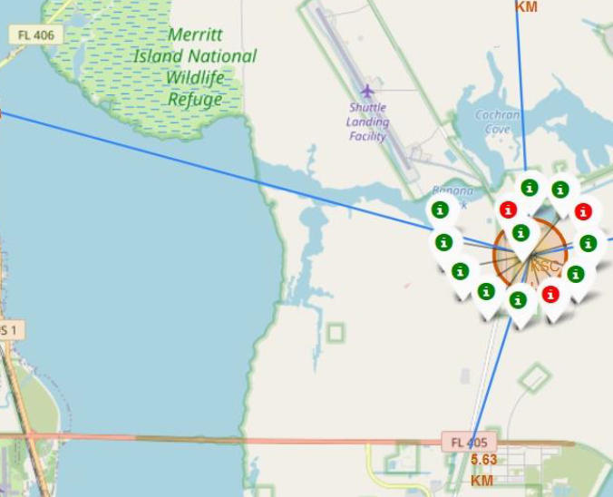
Build an Interactive Map with Folium
The launch success rate may depend on many factors such as payload mass, orbit type.
It may also depend on the location and proximities of a launch site, i.e., the initial position of rocket trajectories.
The goal of geo plots is to analyzing the existing launch site locations, discover the factors involved in finding an optimal location for building a launch site.
https://github.com/hiepdv/My-submission-Applied-Data-Science-Capstone/blob/0f06c656917dee12b9ea23e824bca77308310a4a/LaunchSite_Location.ipynb

Slide 14
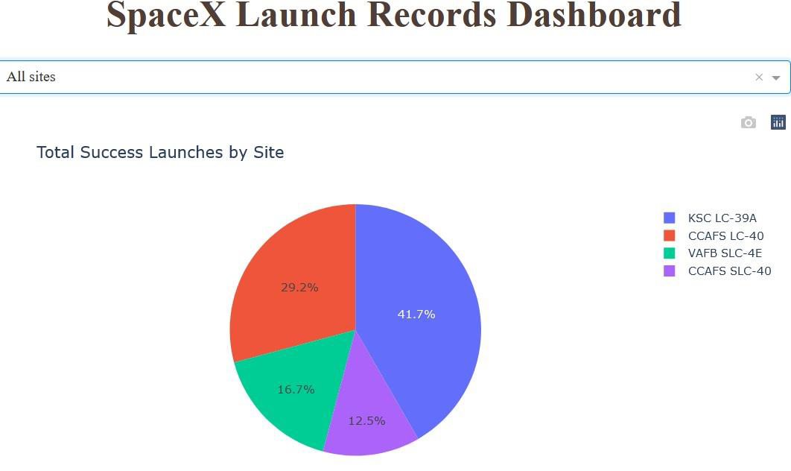
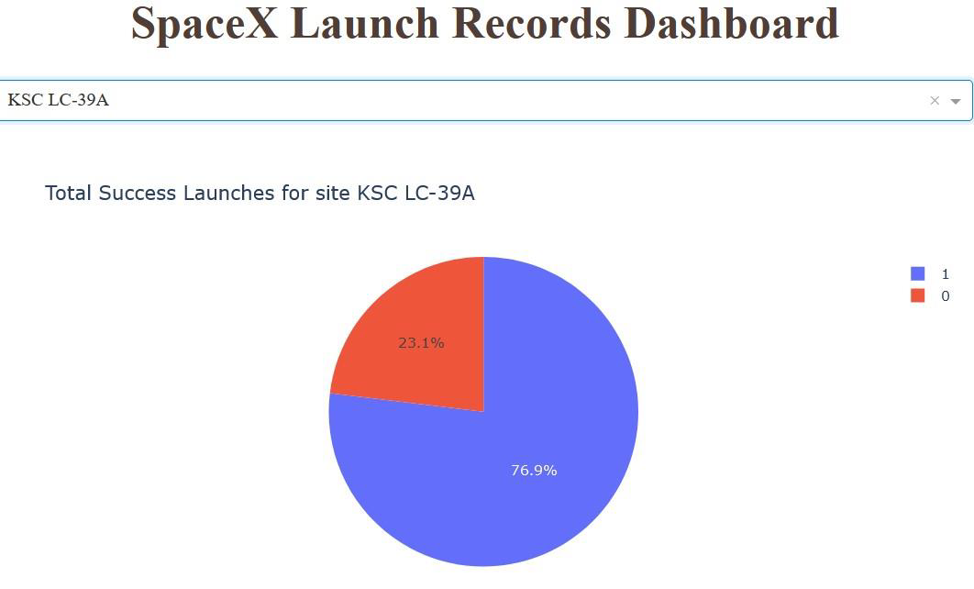
Build a Dashboard with Plotly Dash
Interactive visualization of successful launches per site/ all sites

Slide 15
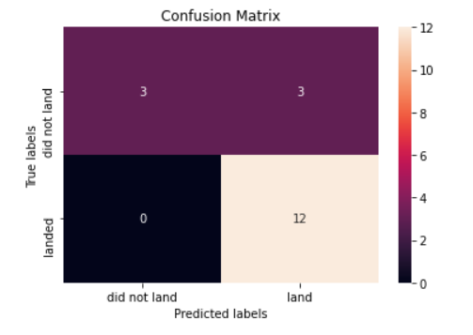
Predictive Analysis (Classification)
KNN, SVM, DecisionTree, LogisticRegression models with tuned hyperparameters by GridSearchCV were built and evaluated by 10 folds Cross Validation.
The highest predictive outcome of 83.3% have KNN, SVM and LogisticRegression algoriths
https://github.com/hiepdv/My-submission-Applied-Data-Science-Capstone/blob/b70e93acb021c8f63122cdc03d97288af74d4139/Machine%20Learning%20Prediction.ipynb

Slide 16
Results
The most successful rate have ES L1, GEO, HEO, SSO orbits
Since 2013 successful launches rate increased from 0 to 90%
For Booster Version FT the optimal payload mass seems to be roughly between 2000 and 4000
The highest rate of successful launches has KSC LC 38A site
KNeighbourClassifier , LogisticRegression and SVM
performed the best on test dataset (83.3% accuracy)

Slide 17

Section 2

Slide 18
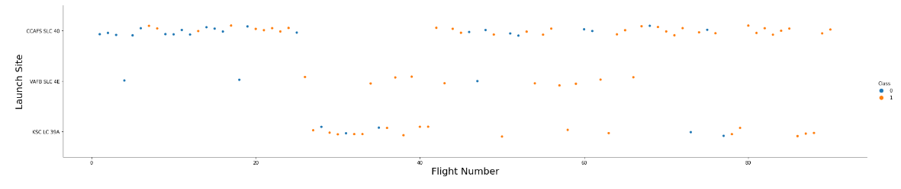
Flight Number vs. Launch Site
Main Launche Site is CCAFS SLC 40 site

Slide 19
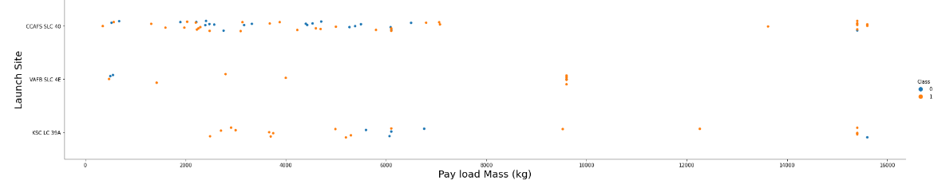
Payload vs. Launch Site

Slide 20
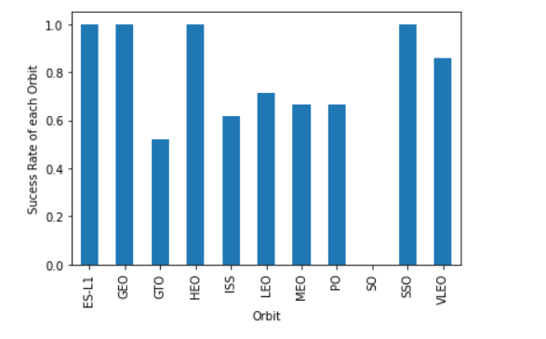
Success Rate vs. Orbit Type
4 orbits with high rate of success are ES=L1, GEO, HEO, SSO orbits launches

Slide 21
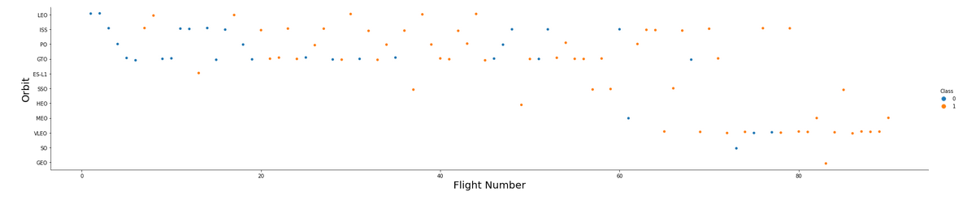
Flight Number vs. Orbit Type
VLEO orbit gain the highest popularity among all types

Slide 22
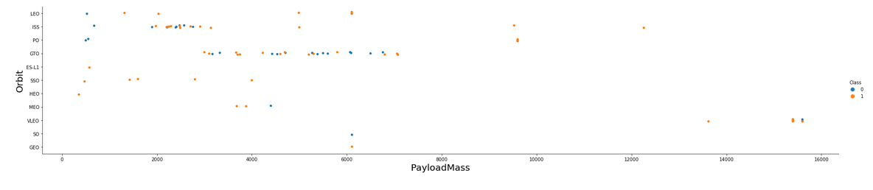
Payload vs. Orbit Type
There are mostly two clusters of payload mass
~1500 3200 (ISS orbit)
~2200 7200 (GTO orbit)

Slide 23
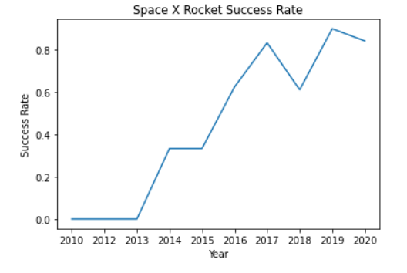
Launch Success Yearly Trend
From 2013, success rate improved rapidly and kept high rate from 2017

Slide 24
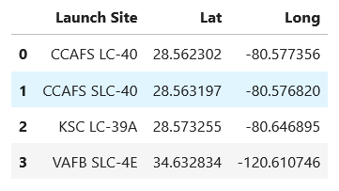
All Launch Site Names
There are 4 Launch Site
CCAFS LC-40
CCAFS SLC-40
KSC LC-39A
VAFB SLC-4E

Slide 25
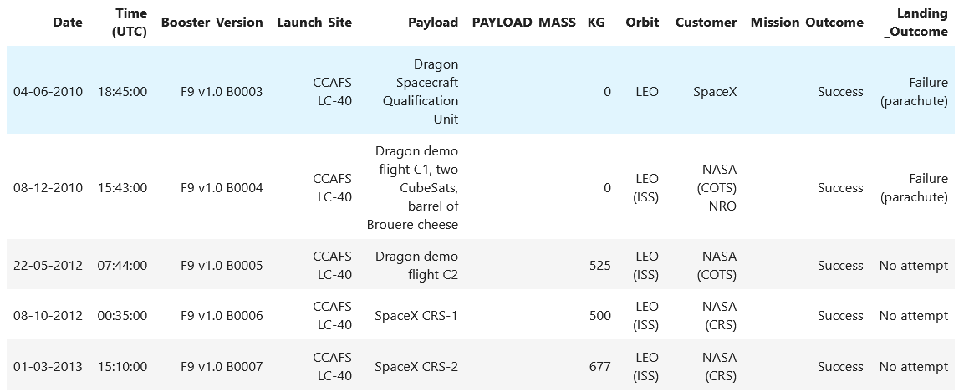
Launch Site Names Begin with 'CCA'
%sql
SELECT * FROM SPACEXTBL WHERE "LAUNCH_SITE" LIKE '%CCA%' LIMIT 5

Slide 26
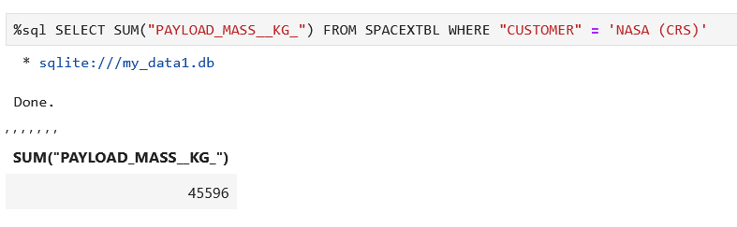
Total Payload Mass

Slide 27
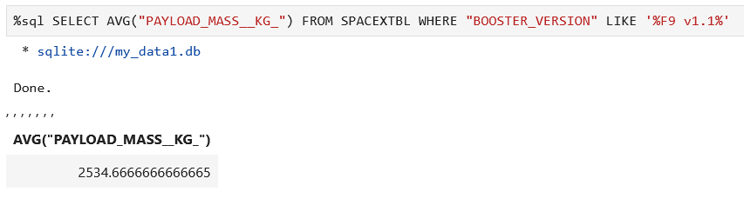
Average Payload Mass by F9 v1.1

Slide 28
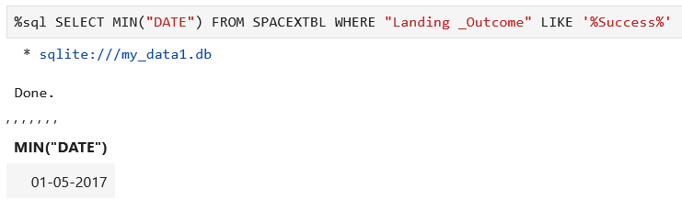
First Successful Ground Landing Date

Slide 29
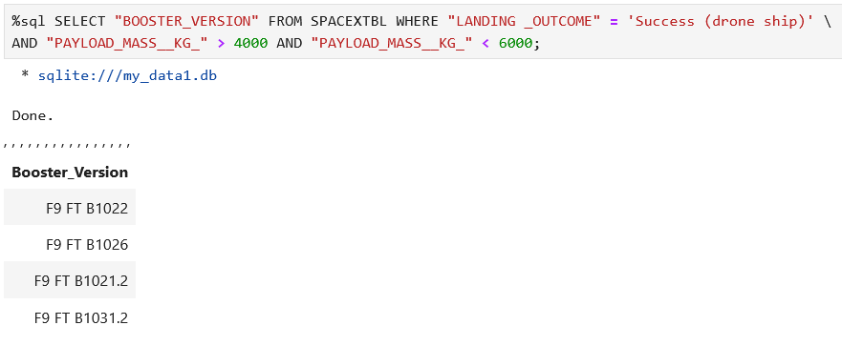
Successful Drone Ship Landing with Payload between 4000 and 6000

Slide 30
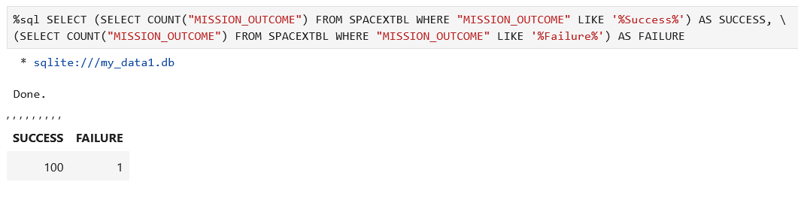
Total Number of Successful and Failure Mission Outcomes

Slide 31
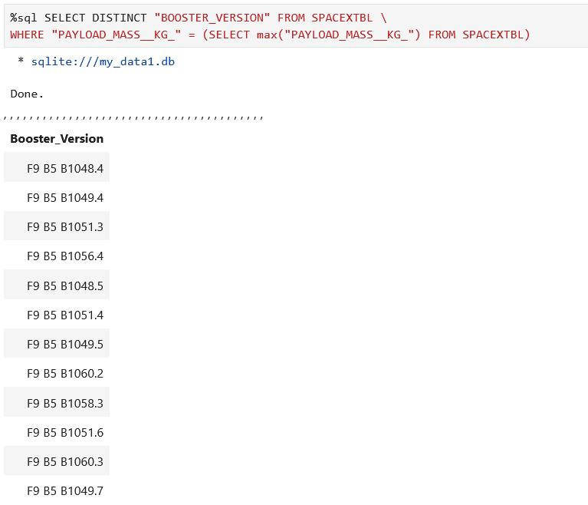
Boosters Carried Maximum Payload

Slide 32
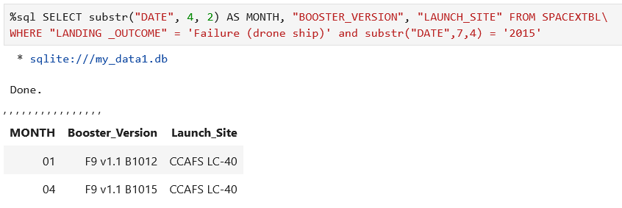
2015 Launch Records

Slide 33
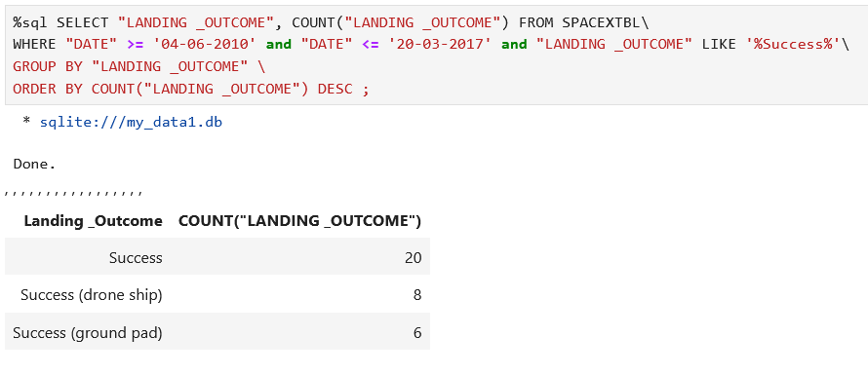
Rank Landing Outcomes Between 2010-06-04 and 2017-03-20

Slide 34

Section 3

Slide 35
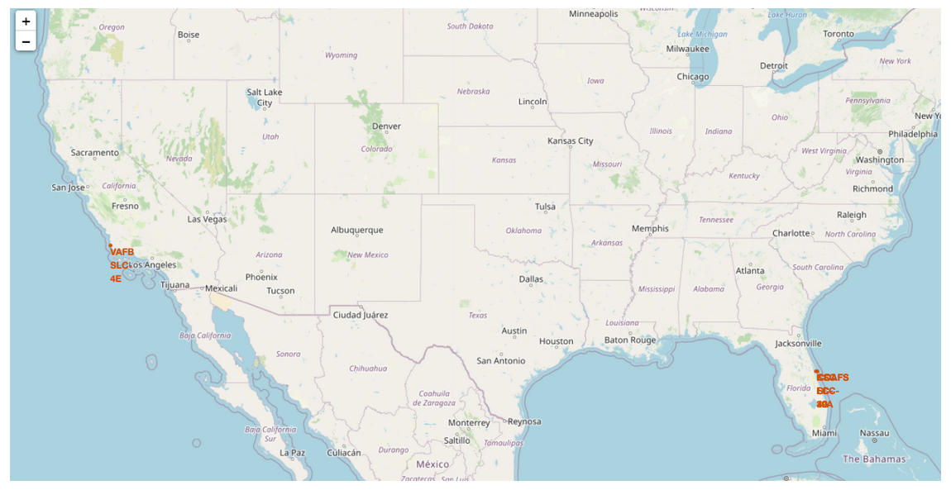
<Folium Map Screenshot 1>

Slide 36
<Folium Map Screenshot 2>
KSC LC-39A is the most successful site with 10 of 13 successful launches outcomes

Slide 37
<Folium Map Screenshot 3>
All sites are in a close proximity to coast line and railway (max~7km)

Slide 38

Section 4

Slide 39
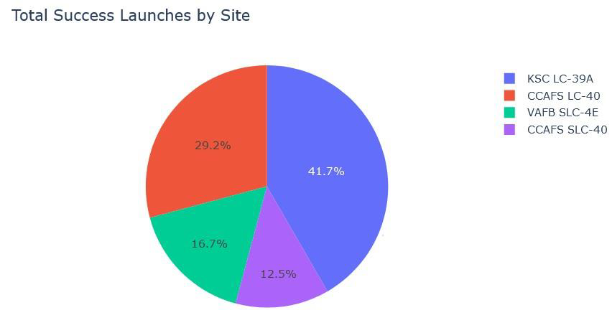
<Dashboard Screenshot 1>
KSC LC-39A is the higher success rate

Slide 40
<Dashboard Screenshot 2>

Slide 41
<Dashboard Screenshot 3>

Slide 42

Section 5

Slide 43
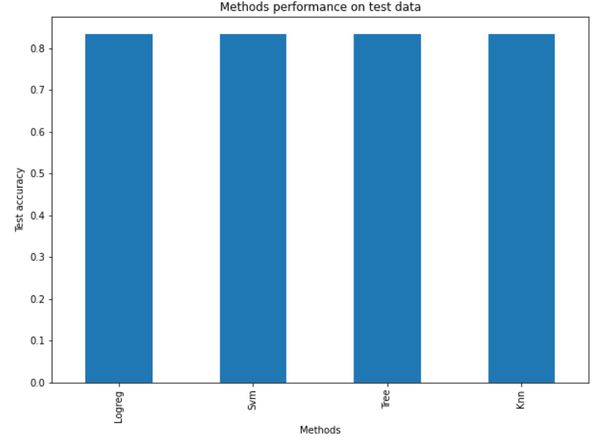
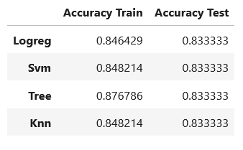
Classification Accuracy
All models have same accuracy on test dataset

Slide 44
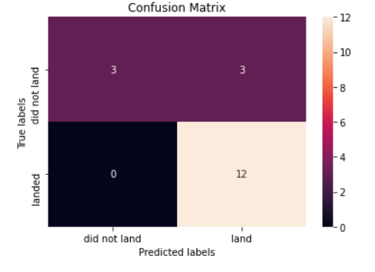
Confusion Matrix

Slide 45
Conclusions
The most successful orbit type are ES-L1, GEO, HEO, SSO
The most successful site is KSC LC-39A (77% success rate)
Payload Mass lower than 5500 havechances for successful launch
The best performed Classifier for this project are KNeighborClassifier, SVM, LogisticRegression
Technologies are constantly developing and from the Launch Success Yearly Trend could be made conclusion that in the future rate of successful launches will continue increasing

Slide 46
Appendix
GitHub Repo for Capstone project
https://github.com/hiepdv/My-submission-Applied-Data-Science-Capstone

Slide 47


